Slide 1
HTML 5

Slide 2

Topic List
Hypertext Markup Language
HTML Terminology
HTML Document Structure
HTML Document Structure Elements
HTML Common/Content Elements
Section Elements
Semantic Structural Tags

Slide 3
Hypertext Markup Language

Slide 4
What is HTML?
HTML – Hyper Text Markup Language
Markup language created by Tim Berners-Lee
A notation language for describing
document structure (semantic markup)
formatting (presentation markup)
Looks (looked?) like:
A Microsoft Word document
The markup tags provide information about the page content structure
An HTML document consists of many tags

Slide 5

Typical Web Page with styling

Slide 6
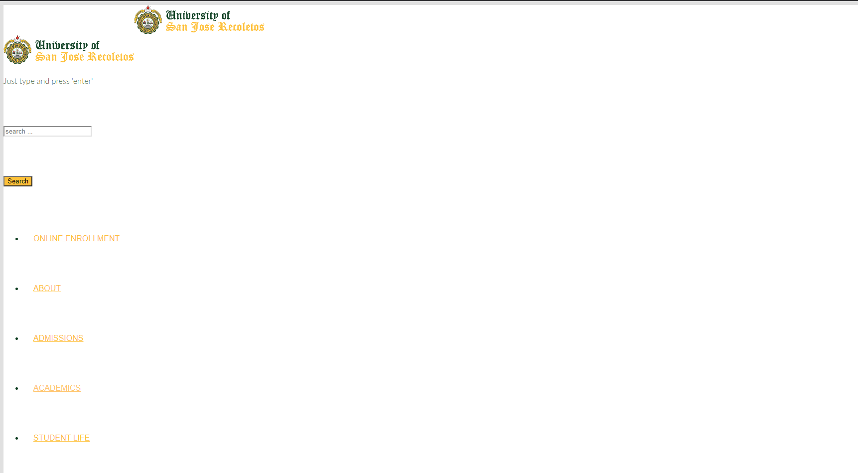
Without styling

Slide 7
Creating HTML Pages
An HTML document must have an .htm or .html file extension
HTML files can be created with text editors:
VS Code, Sublime Text, Atom.io, WebStorm
Or HTML editors (WYSIWYG Editors):
Microsoft Visual Studio
Adobe DreamWeaver
WYSIWYG – What You See Is What You Get
The preference will always be text editors

Slide 8
HTML Standards
W3C - World Wide Web Consortium
Originated by Tim Berners-Lee
Responsible for all the specifications of HTML prior to version 5
Web Hypertext Application Technology Working Group (WHATWG)
Organization of independent authors who are the proponents of the HTML5 standard

Slide 9
HTML – Past, Present, Future
1991 – HTML first mentioned – Tim Berners-Lee – HTML tags
1993 – HTML (first public version, published at IETF)
1993 – HTML 2 draft
1995 – HTML 2 – W3C
1995 – HTML 3 draft
1997 – HTML 3.2 – “Wilbur”
1997 – HTML 4 – ”Cougar” – CSS
1999 – HTML 4.01 (final)
2000 – XHTML draft
2001 – XHTML (final)
2008 – HTML5 / XHTML5 draft
2011 – feature complete HTML5

Slide 10
HTML Terminology

Slide 11
HTML Terminology
Concepts in HTML
Tags
Opening tag and closing tag
The smallest piece in HTML
Attributes
Properties of the tag
Size, color, etc…
Elements
Combination of opening, closing tag and attributes

Slide 12
HTML Tags
Tags are the smallest pieces in an HTML Document
Start with "<" and end with ">"
Two kinds of tags
Opening
Mark the start of an HTML element
Start with the “<“ then the name of the element
Followed by the “>”
Closing
Mark the end of an HTML element
Start in "</“ then the name of the element
Followed by the “>”
Opening tag
Opening tag
Opening tag
<html>
<body>
<h1>Hello USJR</h1>
</body>
</html>
Closing tag
Closing tag
Closing tag

Slide 13
HTML Tags
Some tags have pairs, they are called container elements/tags
Some tags don’t have pairs, they are called empty elements/tags
<!-- this is a container element tag -->
<a href="http://google.com"> go to Google</a>
<!-- this is an empty element -->
<hr width="95%" size="3px"/>
<!-- this is also an empty element -->
<img src="images/USJR-logo.png"/>

Slide 14
Attributes
Attributes are properties of HTML Elements
Used to set size, color, border, etc…
Put directly in the tags
Has value surrounded by " " or ' ‘
HTML 5 access attribute values without double or single quotes
The value is always a string
<!-– makes a hyperlink to Google -->
<a href="http://google.com"> go to Google</a>
<!-– makes a horizontal line -->
<hr width="95%" size="3px"/>
<!-– adds an image in the web page -->
<img src="images/USJR-logo.png"/>

Slide 15
Most common attributes
There are some attributes that are common for every HTML element
id, class, name, style
And some attributes are specific
For example the attribute src of the img element
Shows the path to the image to be shown
<!-– adds an image in the web page -->
<img src="images/USJR-logo.png"/>

Slide 16
HTML Elements
HTML Elements are combination of tags and attributes
Opening tag with some or no attributes and a closing tag
<a href="http://google.com"> go to Google</a>
<html>…</html>

Slide 17
End of Topic

Slide 18
HTML Display and Rendering

Slide 19
How elements are displayed
Every HTML element has a default display behavior
Depends on what type of element it is
The display values are block and inline
Block-level elements - always starts on a new line and takes up the full width available
No other element can be beside a block element
Inline elements - do not start on a new line and it only takes up as much width as necessary
Other elements can exist side-by-side with an inline element

Slide 20
How elements are rendered on page
There is a natural flow of things when elements are rendered on a browser window
This would depend on the type of elements being read from HTML
Inline elements are rendered from left to right
Block-level elements are rendered from top to bottom
It is through this simple dynamic that order is implemented when the layout of a web page is displayed on screen

Slide 21
HTML Document Structure/Elements

Slide 22
!Doctype
Doctype is kind of the validator of the page
Tells the browser in which version of HTML the page is written
HTML 5 Doctype
HTML 4.01 Doctype
XHTML 1.1 Doctype
<!DOCTYPE html>
<!DOCTYPE HTML PUBLIC "-//W3C//DTD HTML 4.01 Transitional//EN" "http://www.w3.org/TR/html4/loose.dtd">
<!DOCTYPE html PUBLIC "-//W3C//DTD XHTML 1.1//EN" "http://www.w3.org/TR/xhtml11/DTD/xhtml11.dtd">

Slide 23
HTML Element
Some elements are essential to each HTML Document:
html, head, body, doctype
The html element
Used to mark the beginning and ending of a HTML document
All the content of the web page is inside this tag
Attribute:
lang – is used to identify the text content of the page
<html>
…
</html>
<html lang=“en”>
…
</html>

Slide 24
Head Element
The head tag contains markup that is not visible to the user
But helps the browser to render correctly the HTML document
What is in there?
styles,
scripts
declare encodings
Etc..
<html>
<head>
....
</head>
....
</html>

Slide 25
Title Element
The title tag is an HTML code tag that allows you to give a web page a title. This title can be found in the browser title bar, as well as in the search engine results pages (SERP).
It is important to note that this title tag is limited in pixels and therefore in characters (512 pixels; approximately 55 characters).
<head>
<title>This is a sample page</title>
...
</head>

Slide 26
Meta Element
The meta tag defines metadata about an HTML document. Metadata is data (information) about data.
<meta> tags always go inside the <head> element, and are typically used to specify character set, page description, keywords, author of the document, and viewport settings.
Metadata will not be displayed on the page, but is machine parsable.
Attributes:
name – indicates a specific meta data identifier
content – specifies the value associated with the http-equiv or name attribute
charset – specifies the character encoding for the HTML document
http-equiv – provides an HTTP header for the information/value of the content attribute

Slide 27
Meta Element
<head>
<meta charset=“UTF-8”>
</head>
<head>
<meta name=“Author” content=“Rabsky”>
</head>
<head>
<meta http-equiv=“refresh” content=“30”>
</head>
<head>
<meta name=“viewport” content=“width=device-width, initial-scale=1.0”>
</head>

Slide 28
Link Element
The link tag defines the relationship between the current document and an external resource.
The <link> tag is most often used to link to external style sheets or to add a favicon to your website.
The <link> element is an empty element, it contains attributes only.
Attributes:
rel – indicates the relationship between the current document and external document/resource
href – indicates the location of the external document/resource
<head>
<link rel="stylesheet" href="styles.css">
</head>

Slide 29
Script Element
The script tag is used to embed a client-side script (JavaScript).
The <script> element either contains scripting statements, or it points to an external script file through the src attribute.
Common uses for JavaScript are image manipulation, form validation, and dynamic changes of content.
Attributes:
src – indicates the location of an external script file usually JavaScript or start of a JavaScript inline code block
type – indicates the MIME type of the external content, can be omitted in HTML 5

Slide 30
Script Element
external .js file
inline JavaScript code
<head>
<script src=“file.js" type=“text/javascript">
</script>
</head>
<head>
<script type=“text/javascript">
let el = document.getElementById(“pholder”);
el.addEventListener(“click”,() => {
alert(“This element is clicked”);
});
</script>
</head>

Slide 31
Style Element
The style tag is used to define style information (CSS) for a document.
Inside the <style> element you specify how HTML elements should render in a browser.
Attribute:
type – specifies the type of data that is being placed inside the style element block, usually this is CSS
<head>
<style type=“text/css”>
h1 {color:red;}
p {color:blue;}
</style>
</head>

Slide 32
Body Element
body element contains all the visible to the user markup
For page content - Headings, text, hyperlinks, images, etc…
For form content - Textboxes, sliders, buttons, etc…
Attributes
bgcolor – sets the overall page background color (deprecated in favor of CSS)
<body id=“mainbody” class=“body-style”>
…
</body>
<body bgcolor=“blue” class=“body-style”>
…
</body>

Slide 33
Body Element
Attributes
background – sets the page default wallpaper (deprecated in favor of CSS)
bgproperties – enables the wallpaper to stop scrolling in the background (deprecated in favor of CSS)
<body background=“images/wallpapers/default.png”>
…
</body>
<body background=“images/wallpapers/default.png” bgproperties=“fixed”>
…
</body>

Slide 34
HTML Document Structure
<!doctype html>
<html>
<head>
<meta charset=“utf-8”>
<meta name=“author” content=“your name”>
<title></title>
<link rel=“stylesheet” href=“” type=“text/css”>
<script type=“text/javascript” src=“”></script>
<style type=“text/css”>
</style>
</head>
<body>
</body>
</html>

Slide 35
End of Topic

